Slide 1
Neuro Rehabilitation

Slide 2
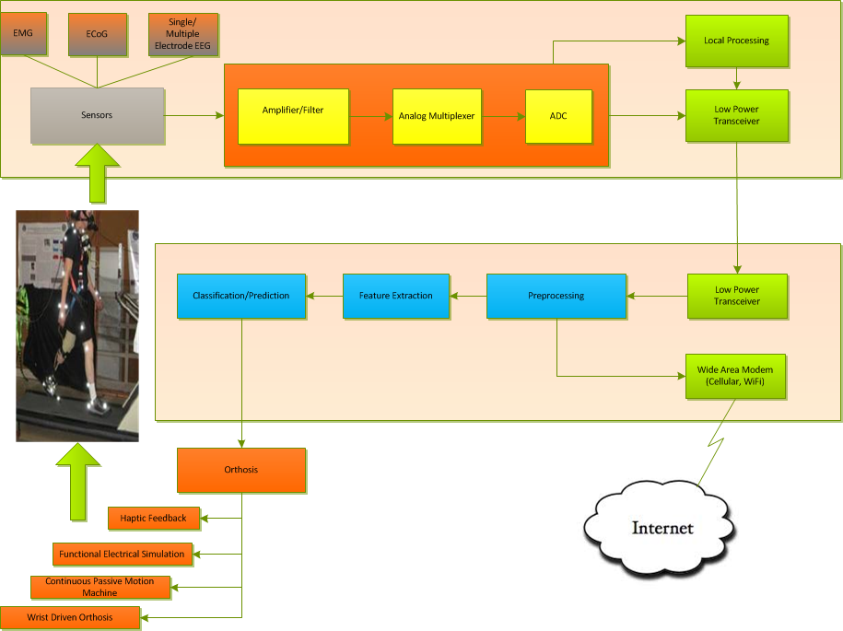

Slide 3
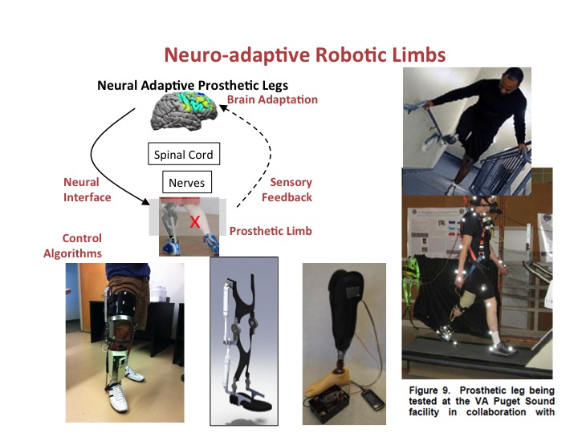
Modular Building Block Structure
Brain/Body
Wearable BCI
External Device
ECoG
Multi-Ch.
ZigBee
Comm.
Module
EMG
VCSEL
Comm.
Module
EEG
Analog Process Module
A/D
DSP Module
BlueTooth
Comm.
Module
Control Module
Wireless I/F
BioSignal I/F
BioData I/F
DSP
Module
Haptic Feedback
Functional Stimulator
Feature Extraction
Passive Motion Machine
Prediction
Wrist Driven Orthosis
Prosthetic Devices

Slide 4
Modular Software Building Block
Brain/Body
Wearable BCI
External Device
Sensory Module
Analog Process Module
A/D
DSP Module
Comm.
Module
Comm.
Module
DSP
Module
Control Module
BioSignal I/F
BioData I/F
Wireless I/F
External Device
Driving
Module
Application
Command API
Command API
Command/Response
Command API
Command API
Command API
Command API
Event/Drive
Event/Drive
Event/Drive
Event/Drive

Slide 5
Command/Response API
Filter
Turn ON/OFF
Power Level Setting
Signal Threshold Setting
Timing
DSP Function
Data Encoding
Module Type
….

